Slide 1
Group 1 Project #2 Non-Technical Overview
Ahmed Sharif, Anmol Talwar, Ashish Maharjan, Benjamin Zhong, Constantinos Cleanthous

Slide 2
Project Schedule
Meeting 1 4/4/2024
Individual Assignments
Meeting 2 4/8/2024
Individual Assignments
Meeting 3 4/12/2024
Draft Submission 4/11/2024
Final Submission 4/13/2024

Slide 3
Meetings & Meeting Notes
Meeting 1 - 4/4/2024
Meeting 2 - 4/8/2024
Meeting 3 - 4/12/2024

Slide 4
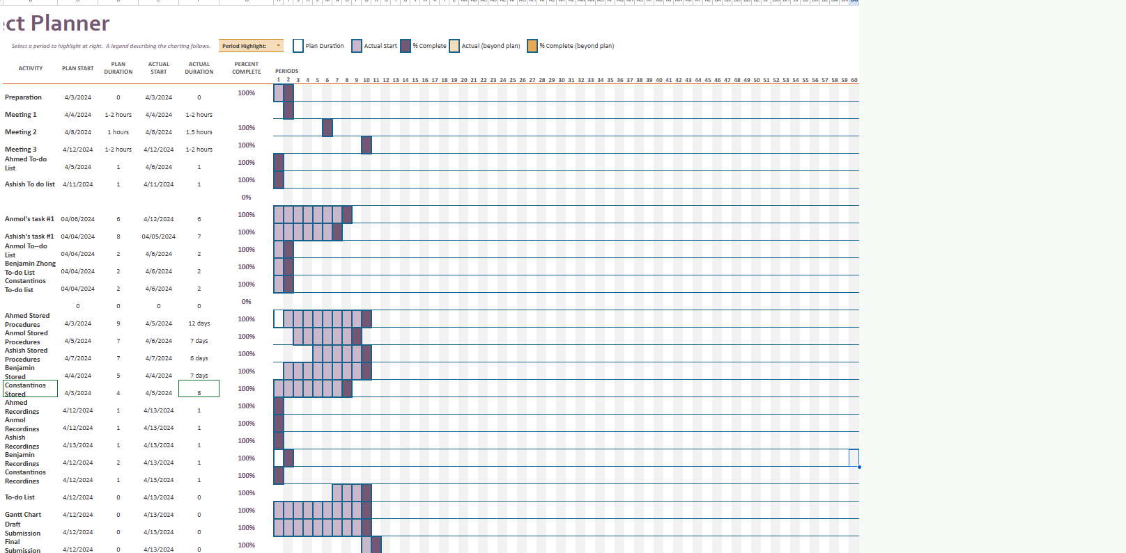
Gantt Chart

Slide 5

Ahmed Sharif (Backup Project Leader)

Slide 6
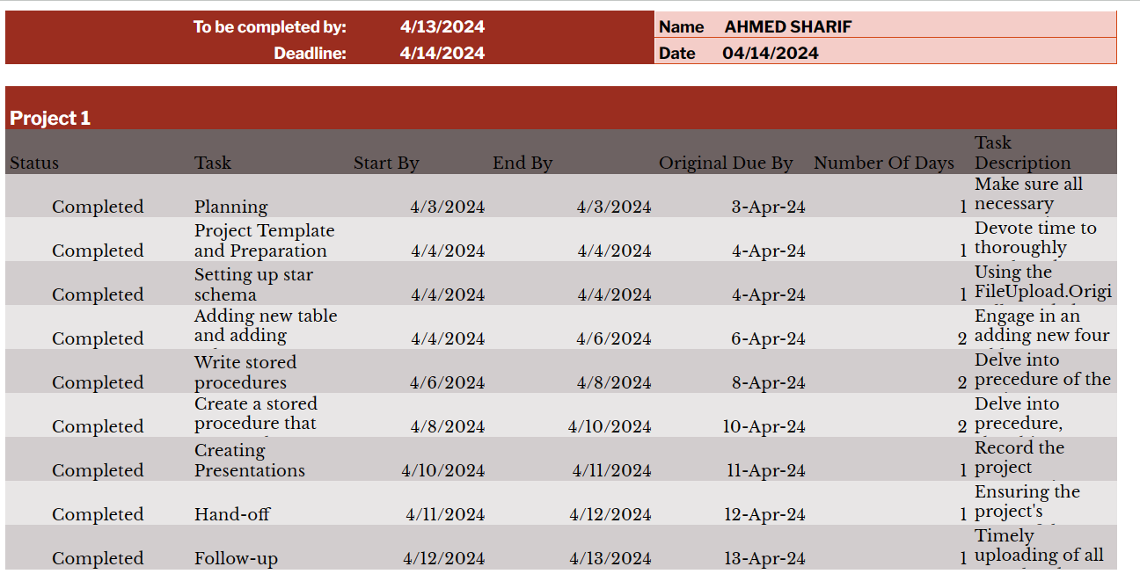
To-do List

Slide 7
Ahmed Sharif - Individual Responsibilities
Stored Procedures
WorkFlowStepCounter
WorkFlowStepsTable
TrackWorkFlow
ShowTableStatusRowCount
Alter Columns in Fact.Date with proper Fk (with Ashish)

Slide 8
Anmol Talwar

Slide 9
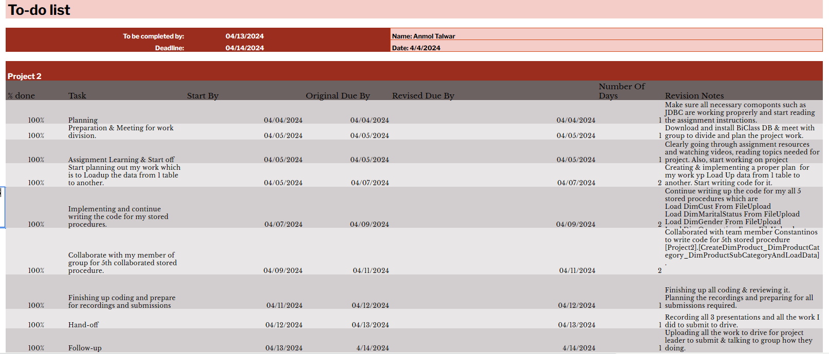
To-do List

Slide 10
Anmol Talwar - Individual Responsibilities
Stored Procedures
Load DimCust From FileUpload
Load DimMaritalStatus From FileUpload
Load DimGender From FileUpload
Load DimOccupation From FileUpload
Load Product, Product Cat, Product SubCat from FileUpload (with Constantinos)

Slide 11
Ashish Maharjan

Slide 12
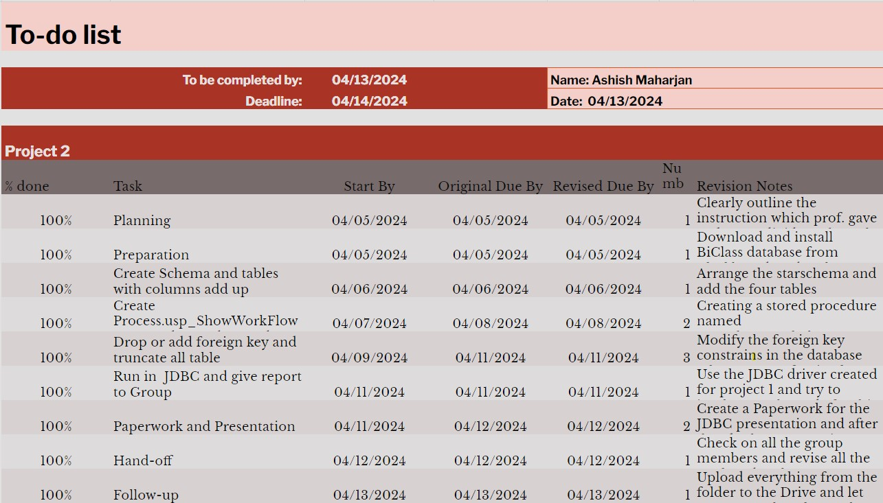
To-do List

Slide 13
Ashish Maharjan - Individual Responsibilities
Stored Procedures
Drop foreign keys from Star Schema
Truncate Star Schema
Alter the columns in Fact.Date with proper Foreign Keys (with Ahmed)
Add Foreign Keys to Star Schema

Slide 14
Benjamin Zhong (Project Leader)

Slide 15
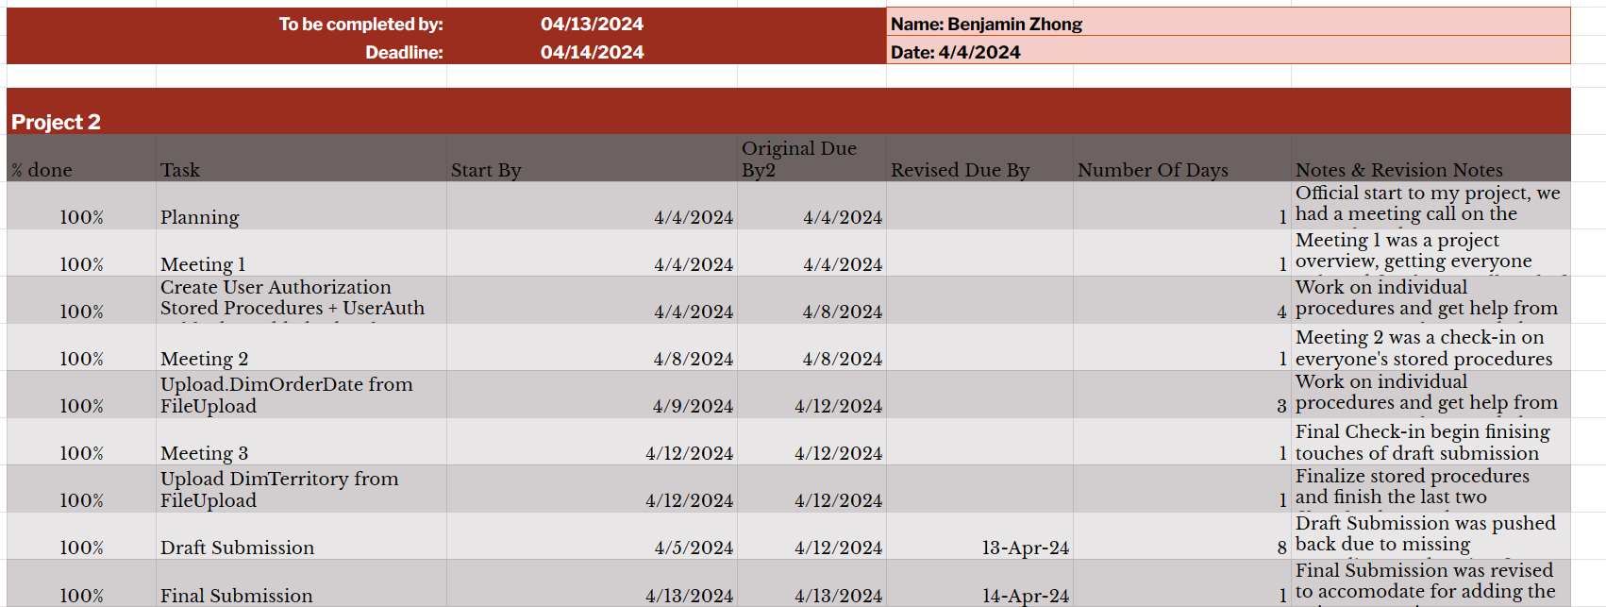
To-do List

Slide 16
Benjamin Zhong - Individual Responsibilities
Stored Procedures
Create UserAuth Table
UserAuth Table date added/date last updated
Load DimOrderDate from FileUpload
Load DimTerritory from File Upload

Slide 17
Constantinos Cleanthous

Slide 18
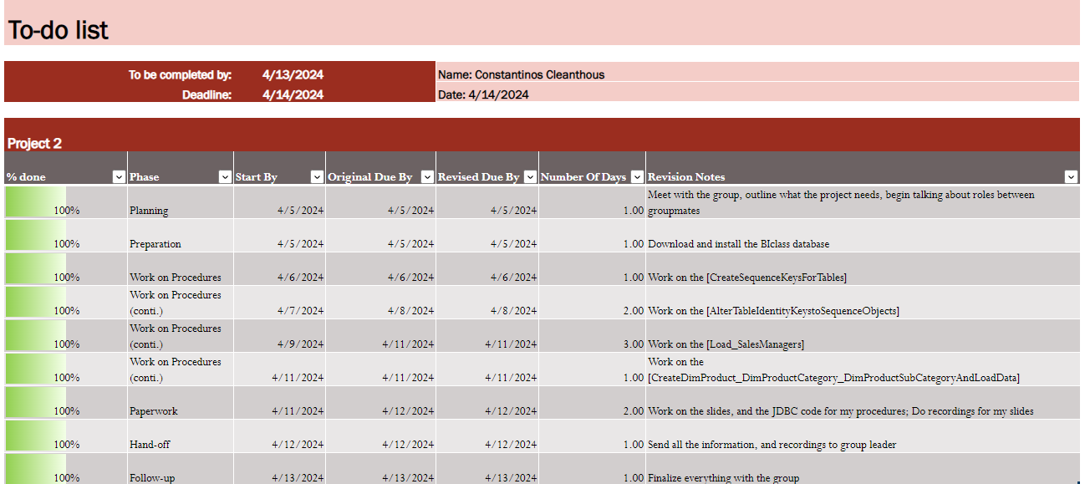
To-do List

Slide 19
Constantinos Cleanthous - Individual Responsibilities
Stored Procedures
Create Sequence Keys
Alter Table Identity keys to sequence objects
Load Sales Managers from FileUpload
Load Product, ProductCat, ProductSubCat (with Anmol)

